Slide 1

Contact:
djacobs1@uncc.edu
Part 5
Exploring Conformational Ensembles
Donald Jacobs, Professor
Department of Physics and Optical Science

Slide 2
Computational Methods Applied to Proteins
A comparison of speed versus accuracy tradeoffs
G = H - TS calculation of free energy requires entropy
Three modeling paradigms
1. Free-energy based
2. Mechanical based
3. Energy based
thermodynamic models
Ising-like thermodynamic models
elastic network model (ENM)
greater speed
Geometrical simulation (GS)
Go-like Molecular Mechanics (MM)
all-atom MM in implicit solvent
not tractable
all-atom explicit MM
MM/QM
QM
greater accuracy

Slide 3
Computational Methods Applied to Proteins
A comparison of speed versus accuracy tradeoffs
G = H - TS calculation of free energy requires entropy
Pros and Cons
Pros: Dynamics & thermodynamics can be studied
Cons: Requires long simulations: Low throughput
greater speed
Go-like Molecular Mechanics (MM)
all-atom MM in implicit solvent
all-atom explicit MM
MM/QM
greater accuracy

Slide 4
Computational Methods Applied to Proteins
A comparison of speed versus accuracy tradeoffs
G = H - TS calculation of free energy requires entropy
Pros and Cons
Pros: Quickly identifies native conformational motions
Cons: Cannot predict thermodynamic properties
elastic network model (ENM)
greater speed
Geometrical simulation (GS)
greater accuracy

Slide 5
Computational Methods Applied to Proteins
A comparison of speed versus accuracy tradeoffs
G = H - TS calculation of free energy requires entropy
minimal Distance Constraint Model
Pros and Cons
Pros: Ensemble based method. Links structure to conformational entropy to enable rapid free energy calculations.
Cons: Relies on native state topology.
Cannot predict dynamic properties.
mDCM
greater speed
greater accuracy

Slide 6
Computational Methods Applied to Proteins
A comparison of speed versus accuracy tradeoffs
G = H - TS calculation of free energy requires entropy
Hybrid Method
Pros and Cons
Pros: Non-native contacts allowed. Free energy driven exploration of conformational pathways.
Cons: Cannot predict true
dynamic properties with respect to time scales.
minimal Distance
Constraint Model
mDCM
greater speed
Geometrical simulation (GS)
greater accuracy

Slide 7
Protein Dynamics is Linked to Network Rigidity
Merging geometrical and topological properties
Geometrical Simulation
of Protein Dynamics
Geometrical Simulation compared to Molecular Dynamics and Elastic Networks:
C. David and D.J. Jacobs, Characterizing protein motions from structure,
J. Mol. Graph Model, 31:41-56 (2011)

Slide 8
Geometrical Simulation (GS)
Exploration of conformations for fixed constraint topology
High Level Overview
Input initial
protein
structure
1. Identify constraint topology
2. Identify all rigid clusters using network rigidity
Relaxation Step
Restore constraints that connect rigid clusters
Monte Carlo Step
Randomize position and orientation
of all rigid clusters in the network.
finished
?
no
yes
stop
Daniel W. Farrell, Ph.D. Thesis, Generating stereochemically
acceptable protein pathways, Arizona State University (2010)

Slide 9
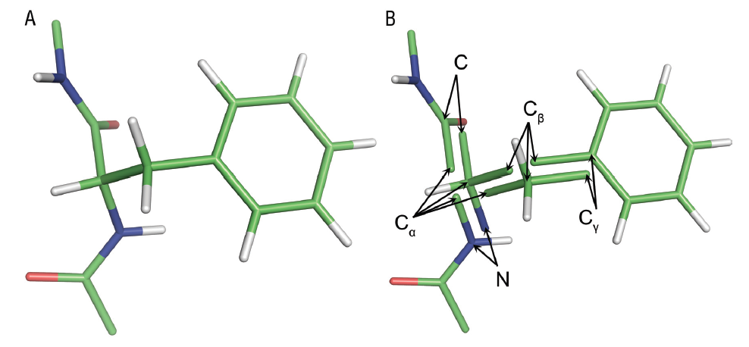
Geometrical Simulation (GS)
An example of Rigid Cluster Decomposition (RCD)
molecular structure
Identification of rigid clusters using graph rigidity analysis
1. D. Farrell, K. Speranskiy and M.F. Thorpe, Proteins, 78:2908–2921 (2010)
2. Daniel W. Farrell, Ph.D. Thesis, Generating stereochemically
acceptable protein pathways, Arizona State University (2010)

Slide 10
Geometrical Simulation (GS)
An example of Rigid Cluster Decomposition (RCD)
FRODA = Framework Rigidity Optimized Dynamics Algorithm
molecular structure → RCD creates multiple copies of atoms
1. D. Farrell, K. Speranskiy and M.F. Thorpe, Proteins, 78:2908–2921 (2010)
2. Daniel W. Farrell, Ph.D. Thesis, Generating stereochemically
acceptable protein pathways, Arizona State University (2010)

Slide 11
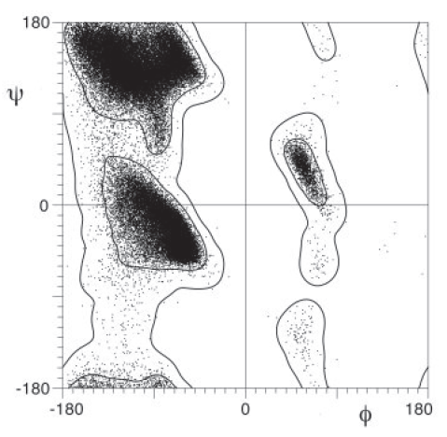
Geometrical Simulation (GS)
Distance inequalities maintain canonical local structural characteristics
Example
Ramachandran plots as well as rotamers are reproduced using distance inequality potentials.
GS parameters were optimized** to keep local geometries that are sampled statistically equivalent to structures from X-ray crystals and that generated by MD simulation.
See: B.K. Ho, A. Thomas and R. Brasseur, Protein Science 12:2508-2522 (2003)
Figure from: S.C. Lovell, J. M. Word, J. S. Richardson and D. C. Richardson. The penultimate rotamer library. Proteins 40:389-408 (2000)
** Daniel W. Farrell, Ph.D. Thesis, Generating stereochemically
acceptable protein pathways, Arizona State University (2010)

Slide 12
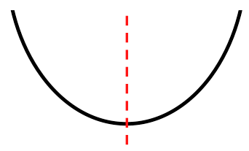
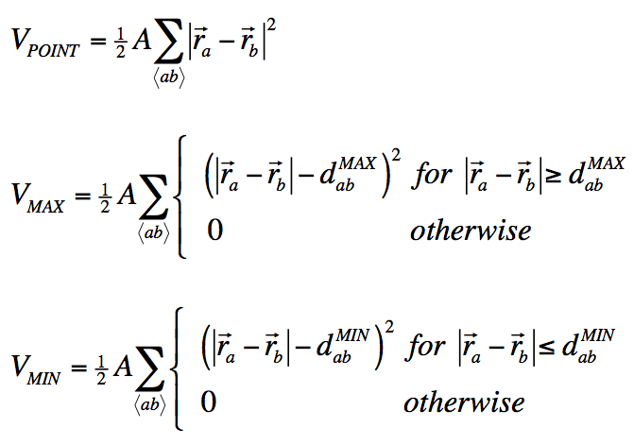


Geometrical Simulation (GS)
Virtual potentials maintain molecular structure
FRODA = Framework Rigidity Optimized Dynamics Algorithm
Shared atoms merge together
Prevent atoms from getting too far apart
Prevent atoms from getting too close
Relaxation Step: Energy minimization method brings constraint network to ZERO energy.
1. D. Farrell, K. Speranskiy and M.F. Thorpe, Proteins, 78:2908–2921 (2010)
2. Daniel W. Farrell, Ph.D. Thesis, Generating stereochemically
acceptable protein pathways, Arizona State University (2010)

Slide 13
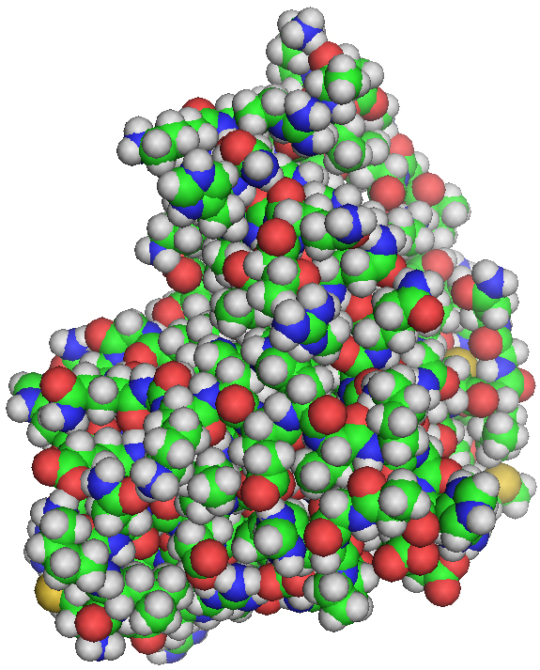
Free Energy Driven Geometrical Simulation
From 3D structure to constraint topology
protein structure
phenomenological parameters
constraint topology
mDCM
FRODA
Ensemble of Conformations

Slide 14
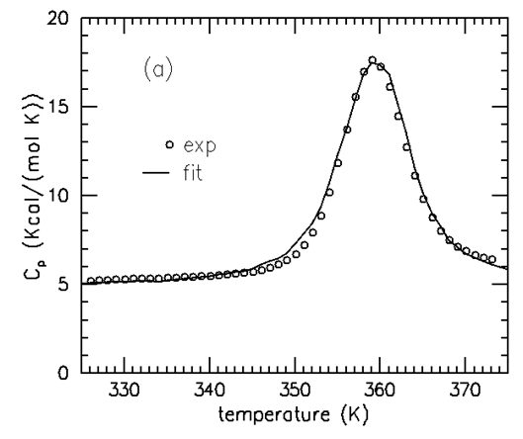
Protein Thermodynamics
Empirical model with 3 fitting parameters: mDCM
Mean Field Theory:
Jacobs & Dallakyan (2005) Biophysical J. 88:903
Livesay et al. (2004) FEBS Letters 576:468
Free energy function: G(N_{hb},N_{nt}) = U_{IHB} – u N_{hb} + v N_{nt} – T(S_{c}(δ_{nat}) + S_{mix})
Experimental input data
NATIVE STRUCTURE + HEAT CAPACITY
Simulated annealing over u, v, δ_{nat}
DCM
OUTPUT
includes
FREE ENERGY
LANDSCAPES

Slide 15
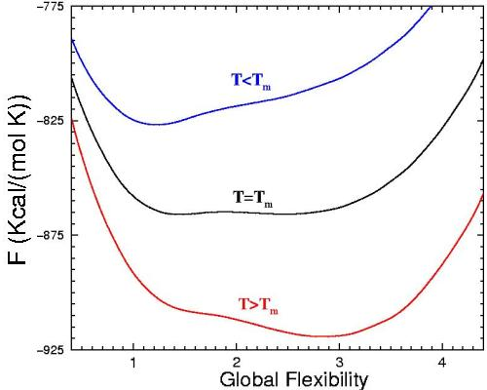
1D Free Energy Landscape
Free energy is directly related to the global flexibility of a protein
number of independent degrees of freedom
Global Flexibility
θ = flexibility order parameter =
number of residues

Slide 16
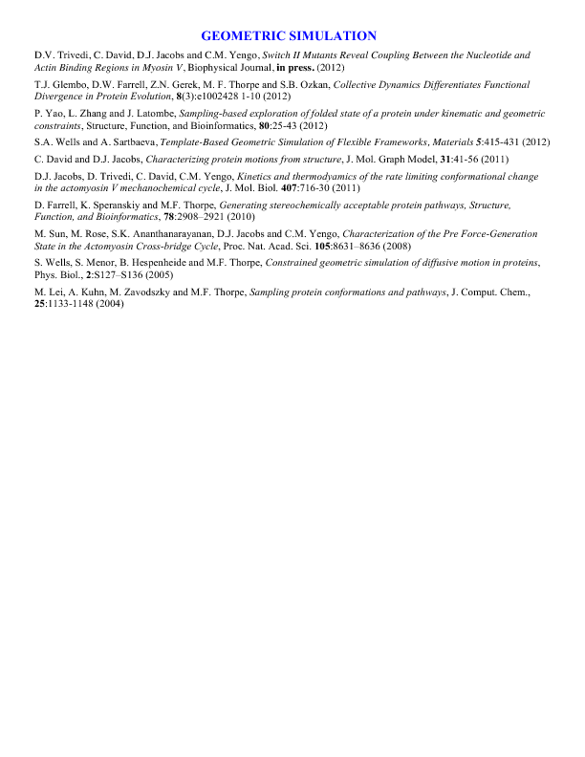
New Hybrid Model
Combining mDCM with GS
High Level Overview
Input initial
protein
structure
1. Apply mDCM (generate free energy landscape)
2. Select new constraint topology (metropolis MC)
3. Identify all rigid clusters using network rigidity
4. Empirically adjust effective time scale (Nsteps)
stop
no
Input: Last geometry
Run FRODA for Nsteps at fixed constraint topology
Output: New geometry for each step.
finished
?
yes

Slide 17
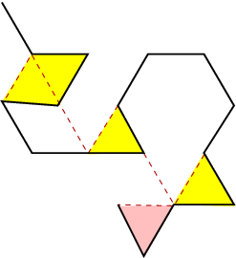
New Hybrid Model
Two dimensional example
mDCM: Determines new constraint topology for fixed geometry
Fluctuating constraint
Quenched constraint
Pink and yellow shaded regions highlight rigid clusters with 3 atoms or more.

Slide 18
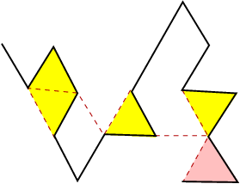
New Hybrid Model
Two dimensional example
GS: Determines new geometry for fixed constraint topology
previous
Fluctuating constraint
Quenched constraint
Pink and yellow shaded regions highlight rigid clusters with 3 atoms or more.

Slide 19
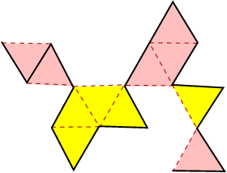
New Hybrid Model
Two dimensional example
mDCM: Determines new constraint topology for fixed geometry
previous
Fluctuating constraint
Quenched constraint
Pink and yellow shaded regions highlight rigid clusters with 3 atoms or more.

Slide 20
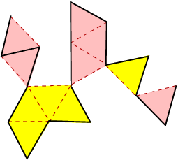
New Hybrid Model
Two dimensional example
GS: Determines new geometry for fixed constraint topology
previous
Fluctuating constraint
Quenched constraint
Pink and yellow shaded regions highlight rigid clusters with 3 atoms or more.

Slide 21
New Hybrid Model
Two dimensional example
An ensemble over constraint topology and conformation is generated that contains native and non-native contacts, driven by free energy!

Slide 22
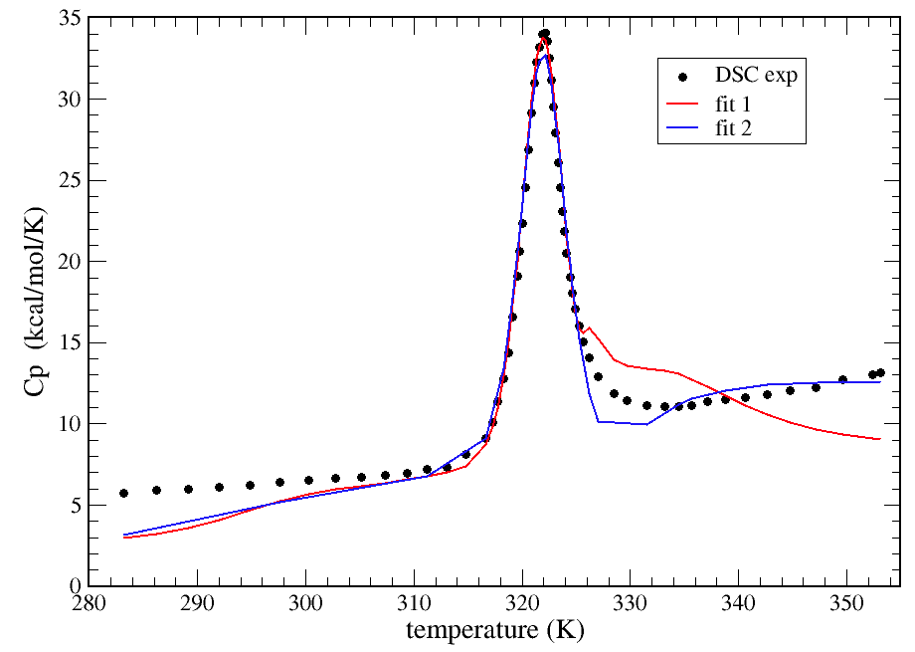
Results
Protein example: (adenylate kinase: 1ake.pdb)
Thermodynamic Properties
Both fits result in virtually the same parameterization.
Heat capacity curve measured by Jorg Rösgen, Penn State University, College of Medicine

Slide 23
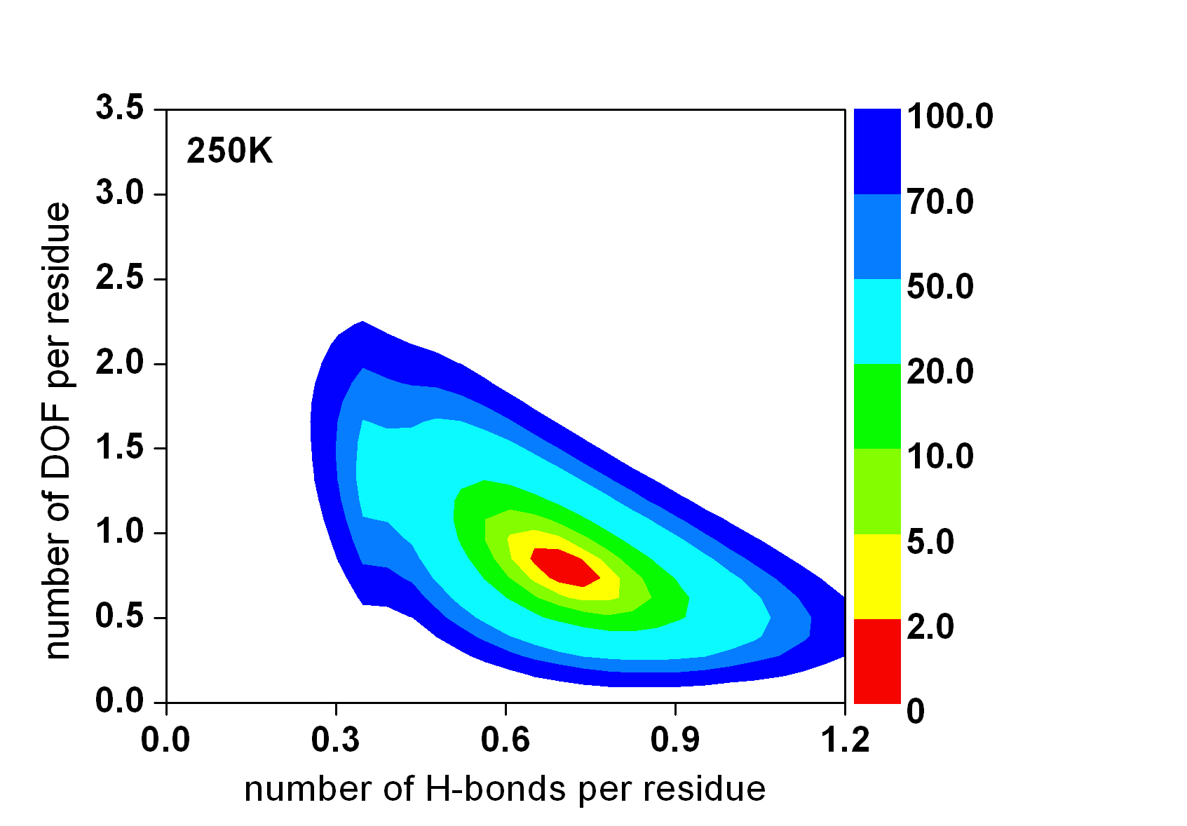
Thermodynamic Properties: 2D-FEL
adenylate kinase
kcal/mol

Slide 24
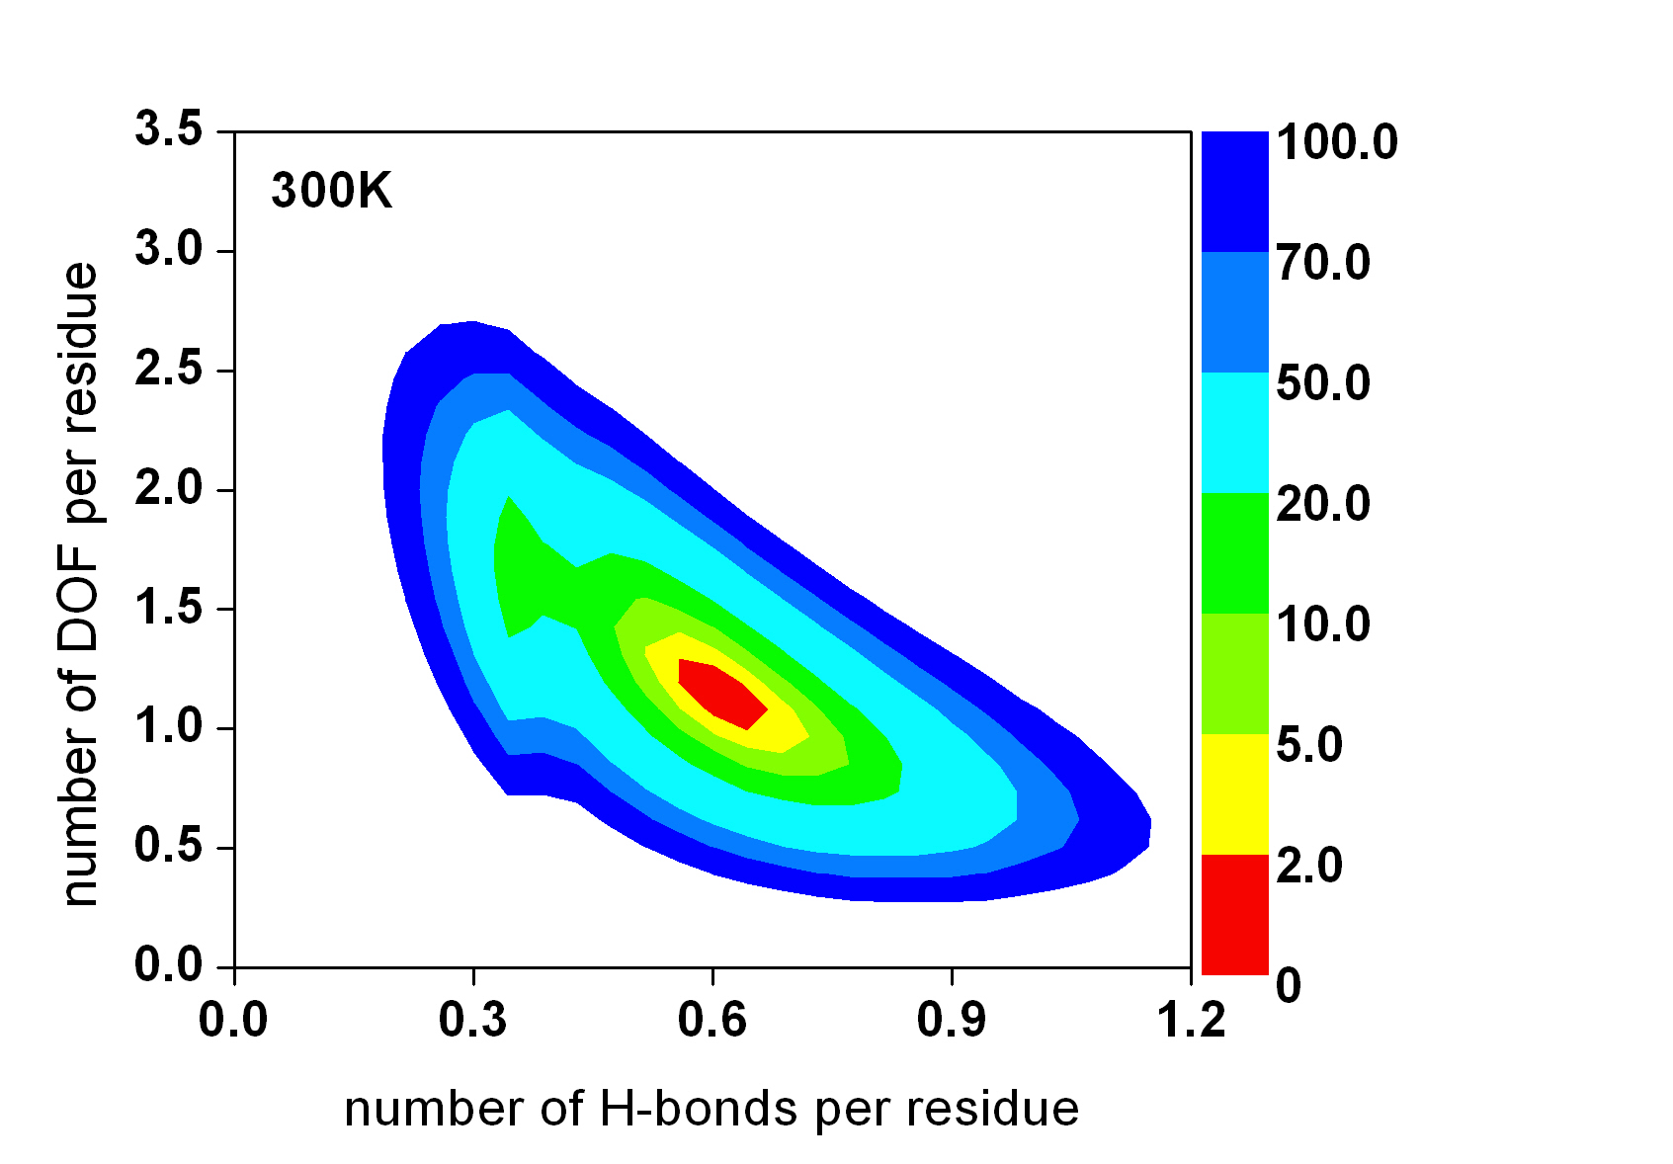
Thermodynamic Properties: 2D-FEL
adenylate kinase
kcal/mol

Slide 25
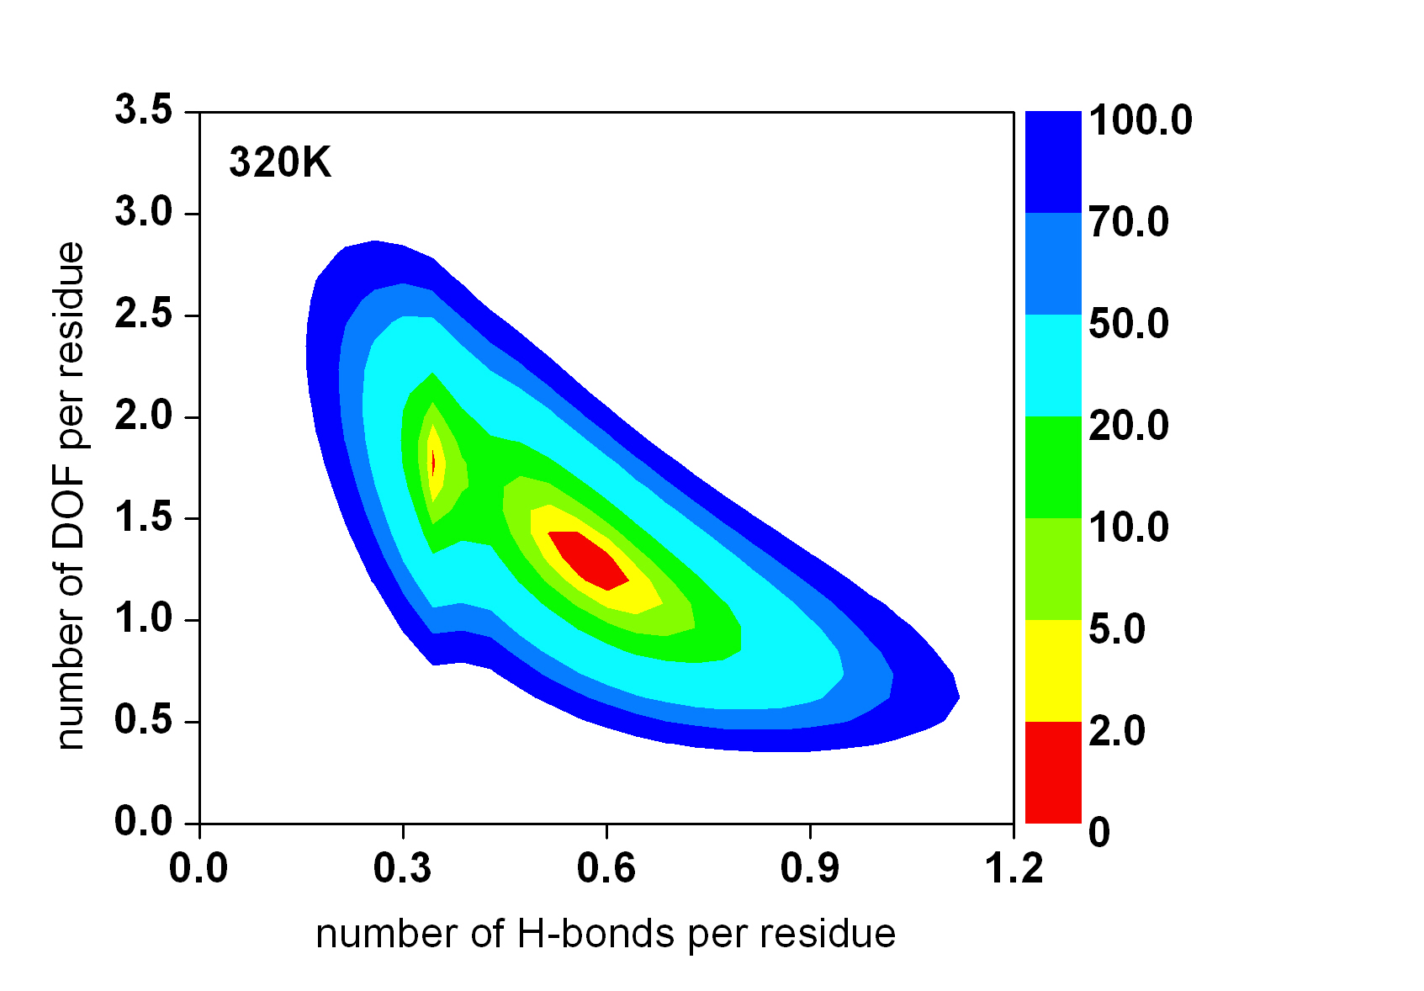
Thermodynamic Properties: 2D-FEL
adenylate kinase
kcal/mol

Slide 26
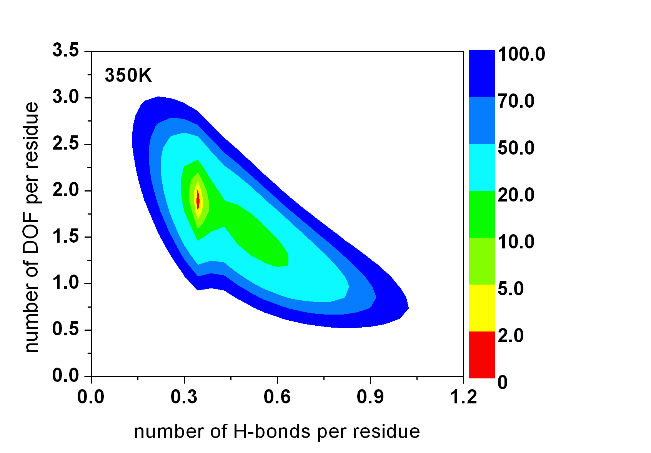
Thermodynamic Properties: 2D-FEL
adenylate kinase
kcal/mol

Slide 27
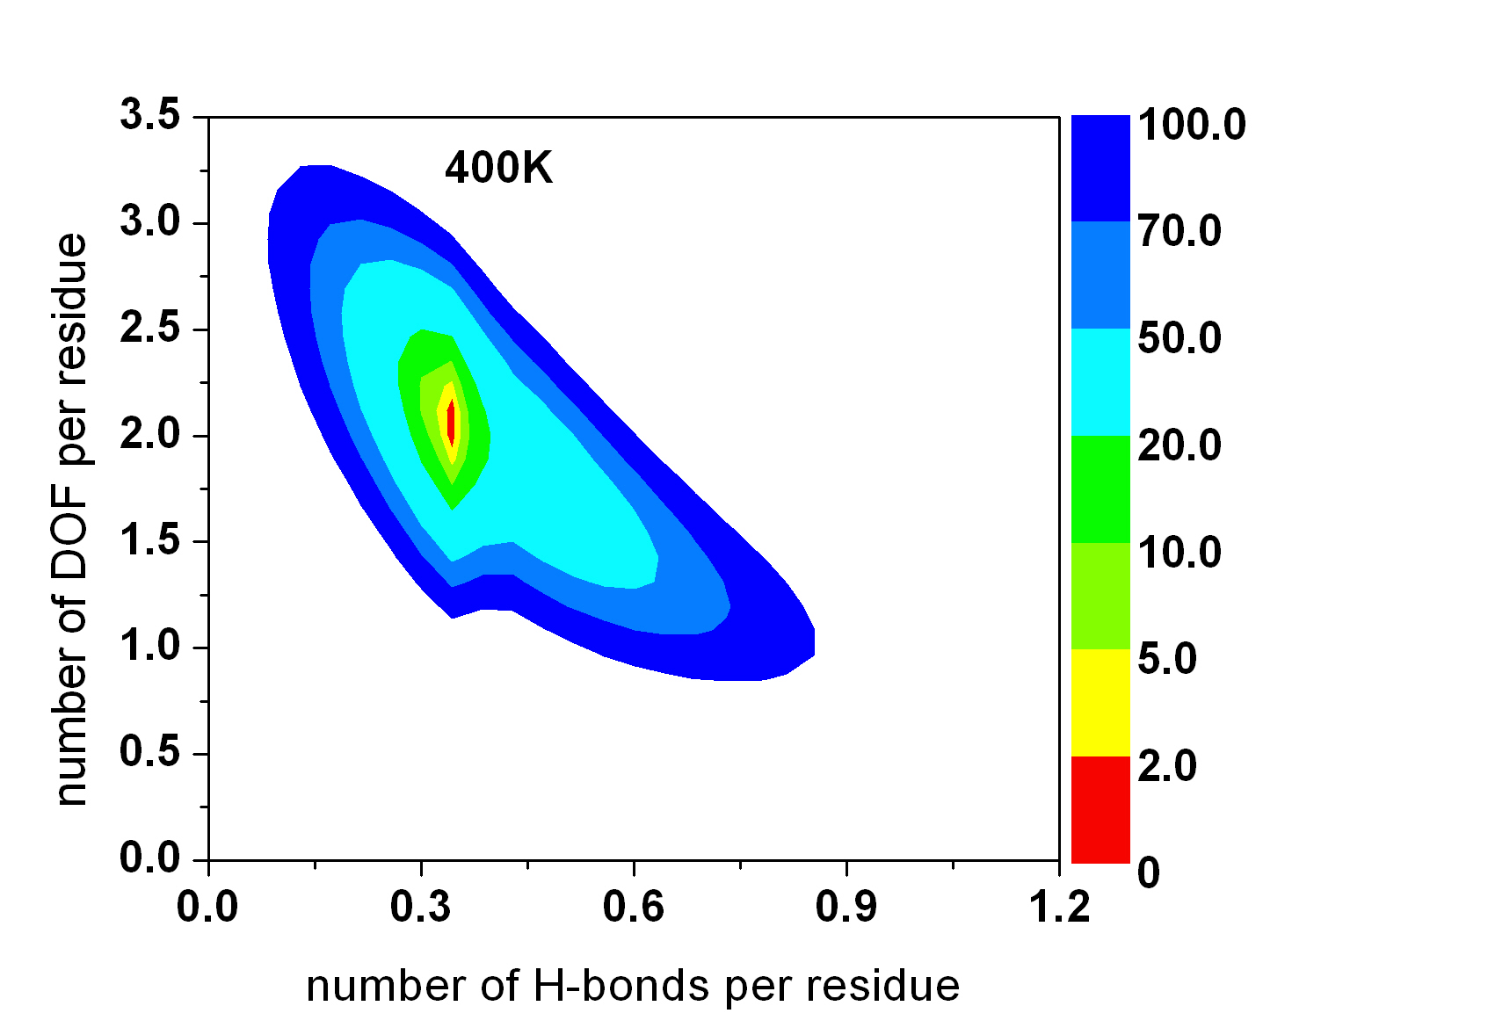
Thermodynamic Properties: 2D-FEL
adenylate kinase
kcal/mol

Slide 28
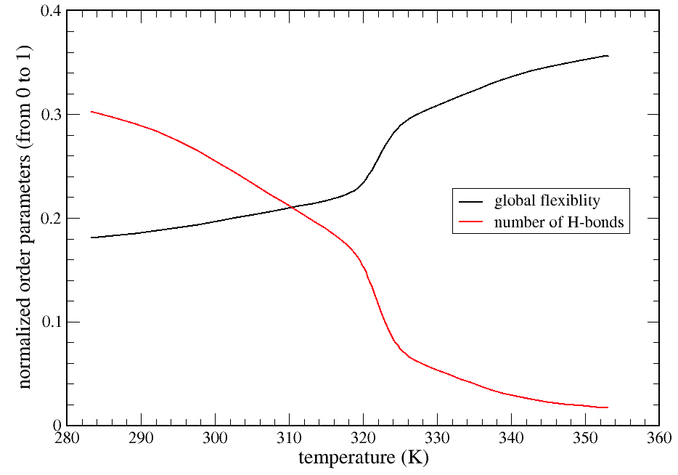
Results
Protein example: (adenylate kinase: 1ake.pdb)
Thermodynamic Properties

Slide 29
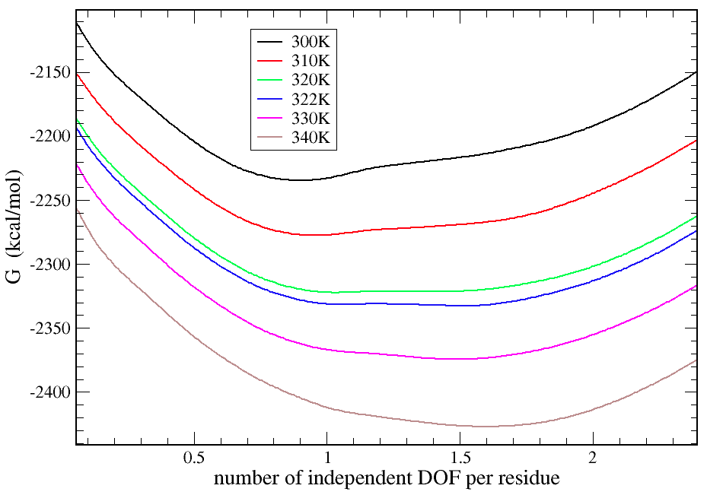
Results
Protein example: (adenylate kinase: 1ake.pdb)
Thermodynamic Properties

Slide 30
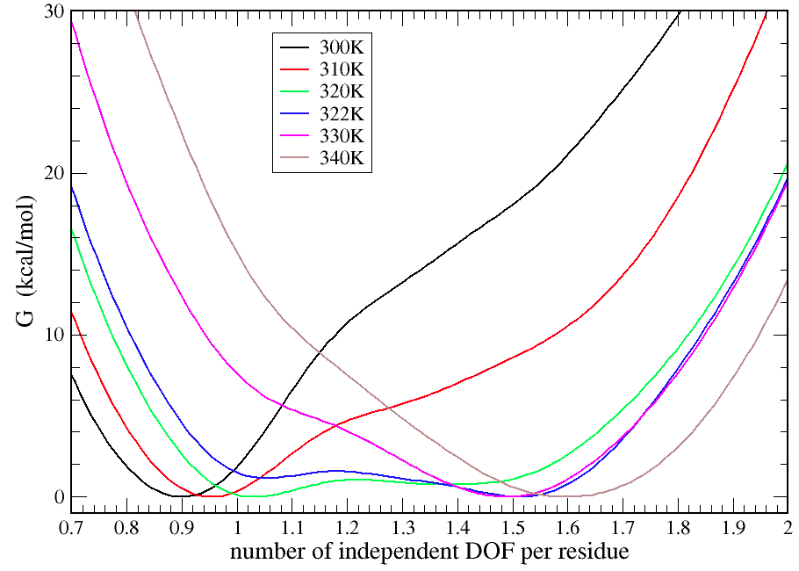
Results
Protein example: (adenylate kinase: 1ake.pdb)
Thermodynamic Properties (zoomed view)

Slide 31
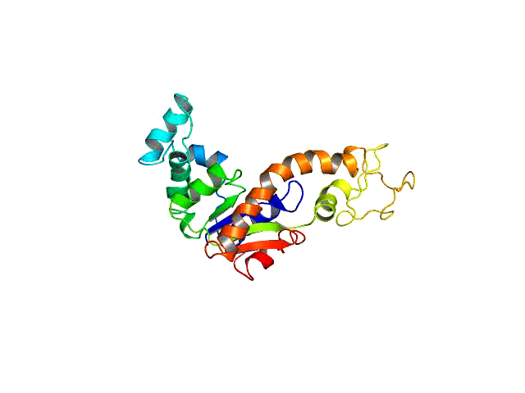
Movie for T=300K
Protein example: (adenylate kinase: 1ake.pdb)

Slide 32
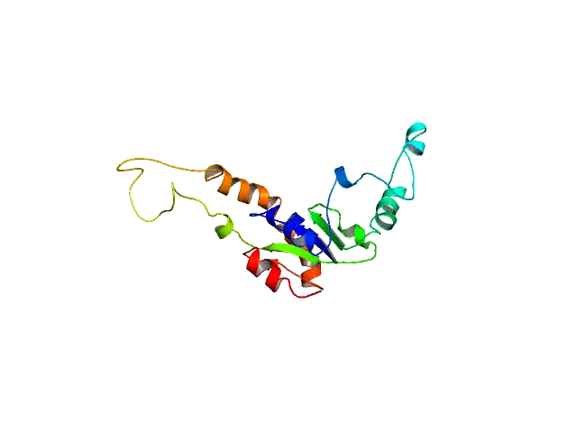
Movie for T=322K
Protein example: (adenylate kinase: 1ake.pdb)

Slide 33
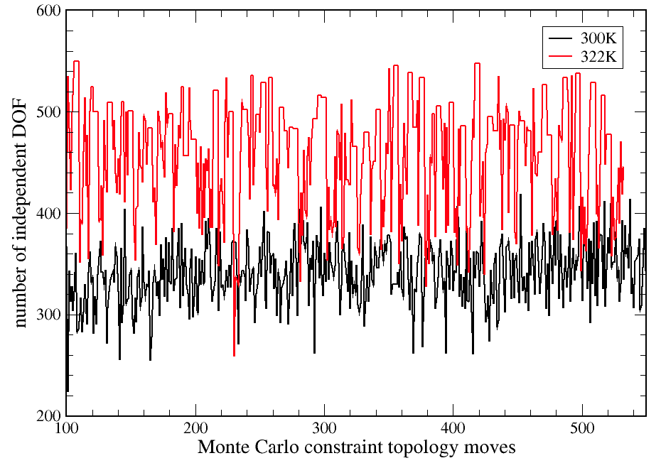
Results
Protein example: (adenylate kinase: 1ake.pdb)
Dynamic Properties

Slide 34
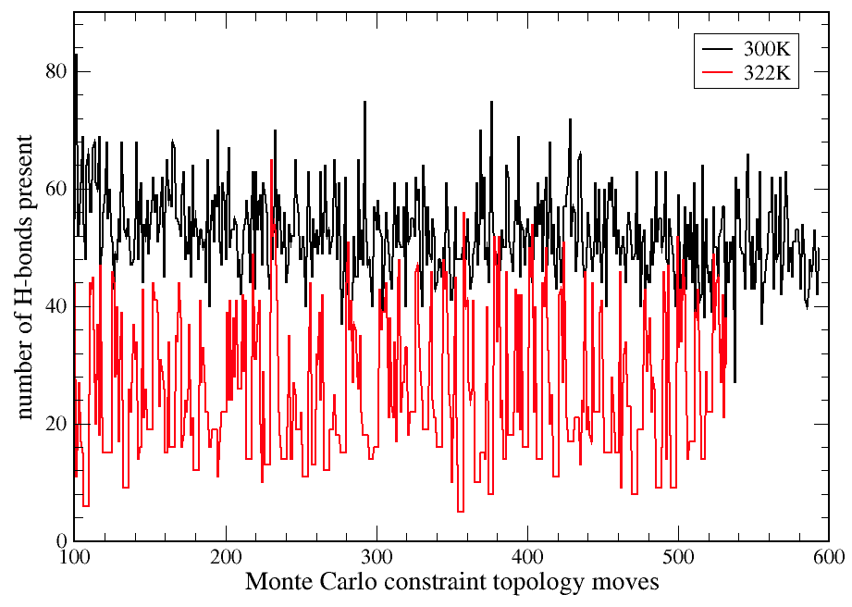
Results
Protein example: (adenylate kinase: 1ake.pdb)
Dynamic Properties

Slide 35
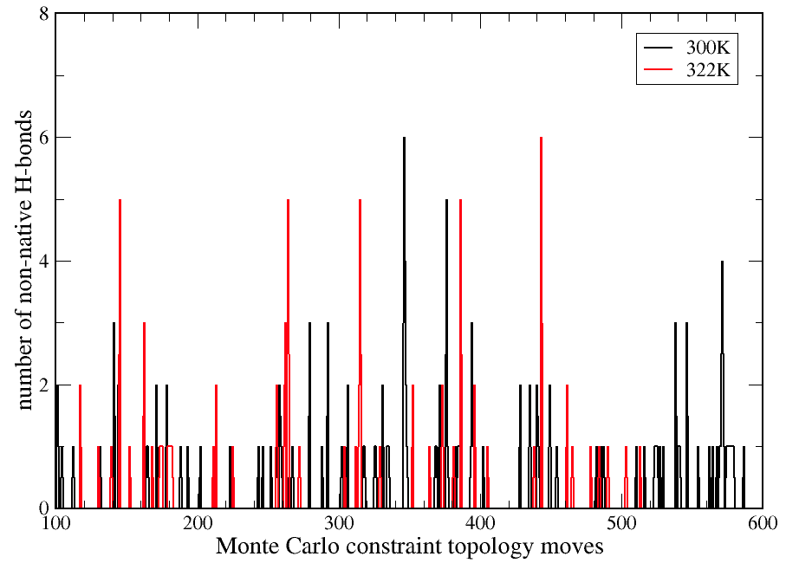
Results
Protein example: (adenylate kinase: 1ake.pdb)
Dynamic Properties

Slide 36
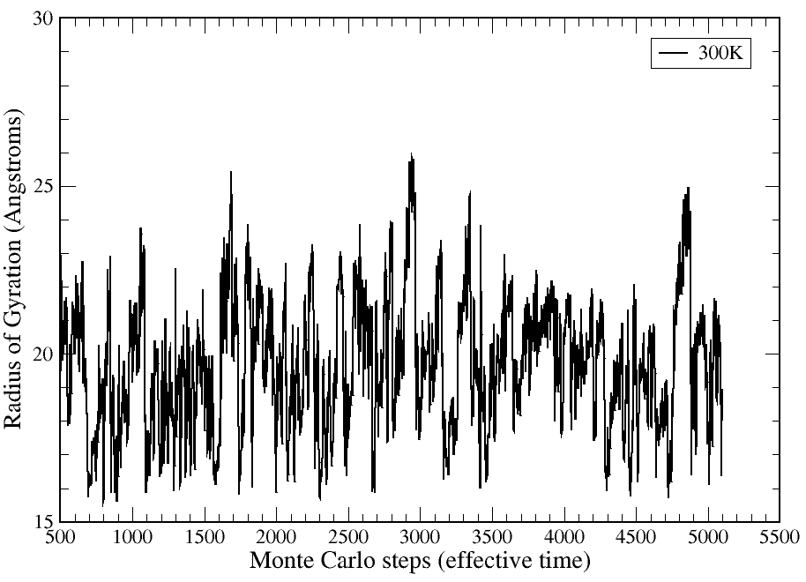
Results
Protein example: (adenylate kinase: 1ake.pdb)
Dynamic Properties
unfolding
events

Slide 37
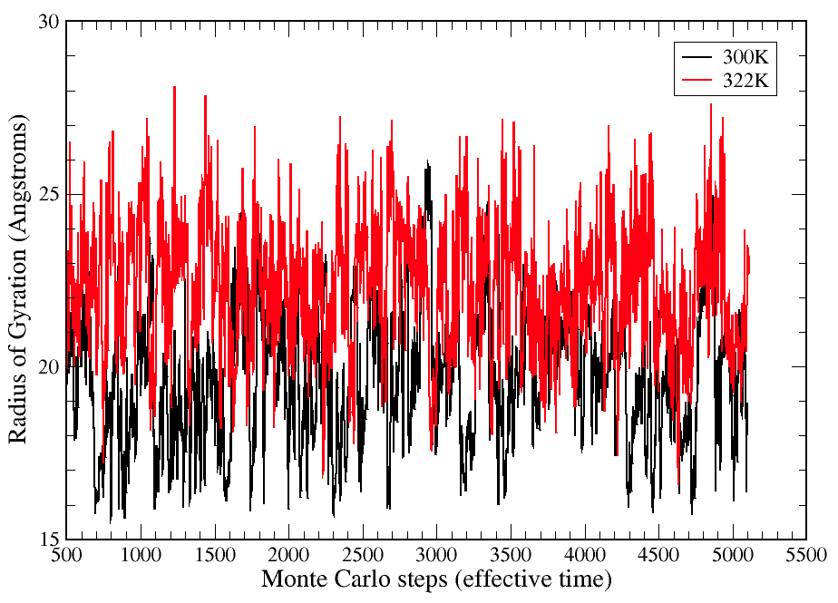
Results
Protein example: (adenylate kinase: 1ake.pdb)
Dynamic Properties

Slide 38
Strobe the Folding - Unfolding Transition
adenylate kinase
External driving with free energy profiles
unfold protein
free energy bias
free energy bias
fold protein
flexibility order parameter
flexibility order parameter

Slide 39
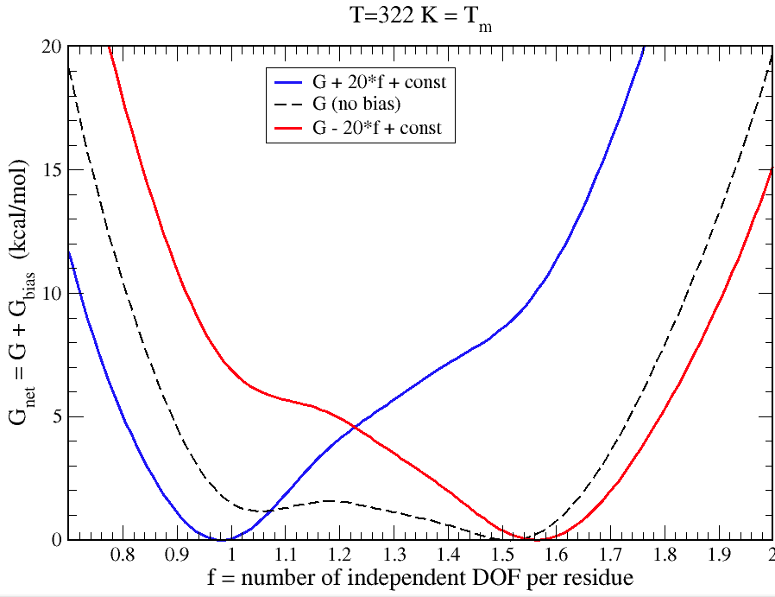
Strobe the Folding - Unfolding Transition
adenylate kinase
External driving with free energy profiles

Slide 40
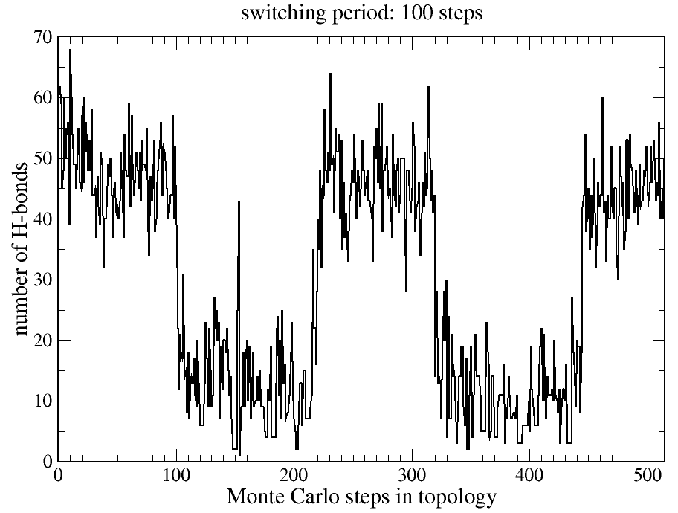
Strobe the Folding - Unfolding Transition
adenylate kinase
External driving with free energy profiles

Slide 41
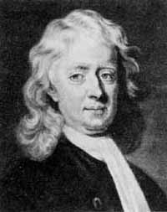
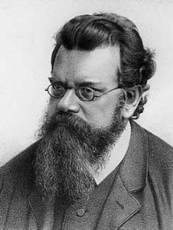
End of Part 5
Network rigidity is a fundamental mechanical property that directly links protein stability, flexibility and dynamics
Newtonian
Mechanics
Boltzmann
Statistics
US Patent No. 6,014,449 (D.J. Jacobs and M.F. Thorpe), Computer Implemented System for Identifying Rigid and Flexible Regions in Macromolecules, (Issued 2000)
U.S. Patent No. 8,244,504 (D.J. Jacobs) Computer Implemented System for Quantifying Stability and Flexibility Relationships in Macromolecules, (Issued 2012)
U.S. Patent No. 8,374,828 (D.J. Jacobs and D.R. Livesay) Computer Implemented System for Protein Design utilizing Quantitative Stability/Flexibility Relationships to control function, (Issued 2013).
U.S. Patent Pending: 61016551 (D.J. Jacobs), Computer Implemented System for Quantifying ensemble averaged properties of rigidity and flexibility in Macromolecules.
Work supported by:
NSF-DMR 96-32182, Research Corporation CC5141, NIH-SBIR R43 GM58337,
NIH-S06 GM48680-0952, NIH-R01 GM 073082, NIH-R21 HL093531, NIH-ARRA-073082, NIH-S10 SRR026514, MedImunne, Inc. , Charlotte Research Institute (CRI)
Center for Biomedical Engineering and Science (CBES)

